Slide 1
A
Course on
PATTERN RECOGNITION
Sergios Theodoridis
Konstantinos Koutroumbas
Version 3

Slide 2
PATTERN RECOGNITION
Typical application areas
  Machine vision
  Character recognition (OCR)
  Computer aided diagnosis
  Speech/Music/Audio recognition
  Face recognition
  Biometrics
  Image Data Base retrieval
  Data mining
  Social Networks
  Bionformatics
The task: Assign unknown objects – patterns – into the correct class. This is known as classification.

Slide 3
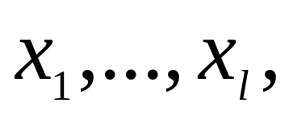
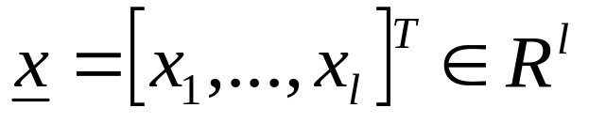
Features: These are measurable quantities obtained from the patterns, and the classification task is based on their respective values.
Feature vectors: A number of features
constitute the feature vector
Feature vectors are treated as random vectors.

Slide 4
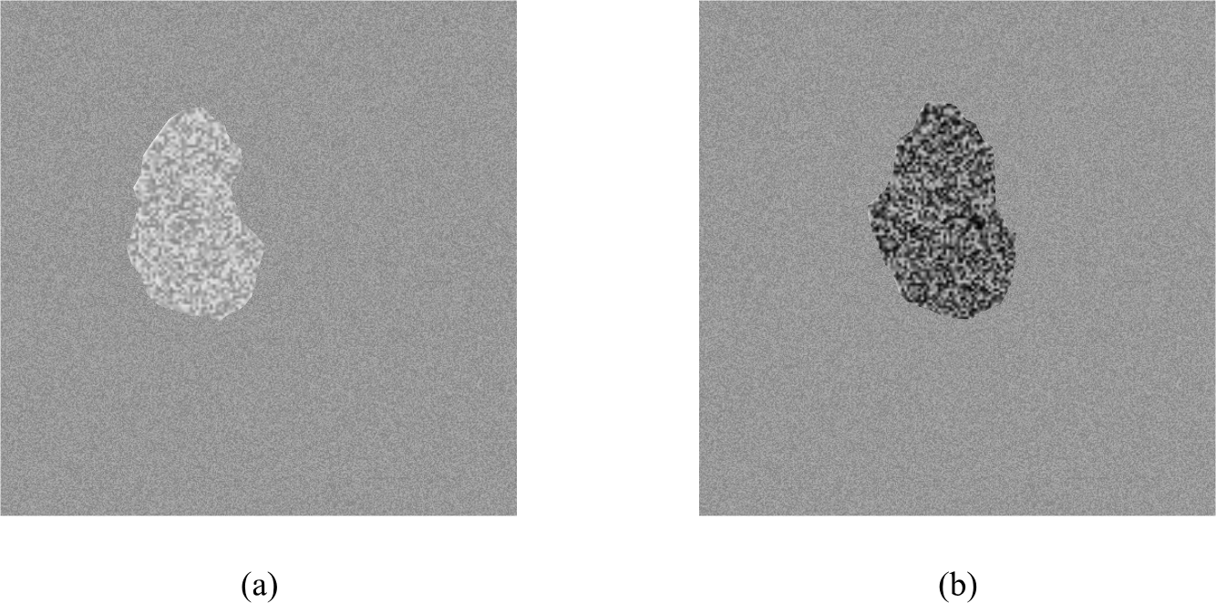
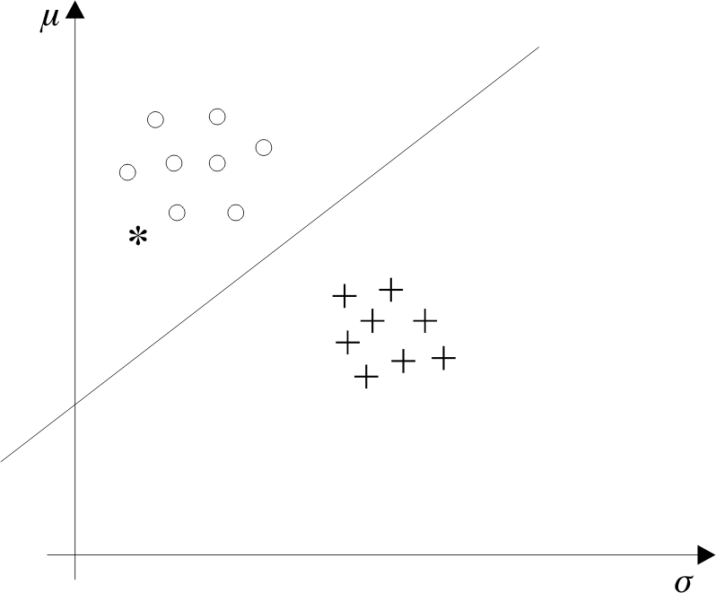
An example:

Slide 5


The classifier consists of a set of functions, whose values, computed at , determine the class to which the corresponding pattern belongs
Classification system overview
Patterns
sensor
feature
generation
feature
selection
classifier
design
system
evaluation

Slide 6
Supervised – unsupervised – semisupervised pattern recognition:
The major directions of learning are:
  Supervised: Patterns whose class is known a-priori are used for training.
  Unsupervised: The number of classes/groups is (in general) unknown and no training patterns are available.
  Semisupervised: A mixed type of patterns is available. For some of them, their corresponding class is known and for the rest is not.

Slide 7
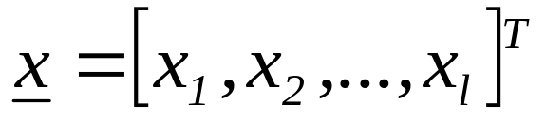

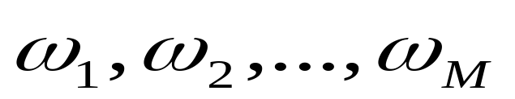
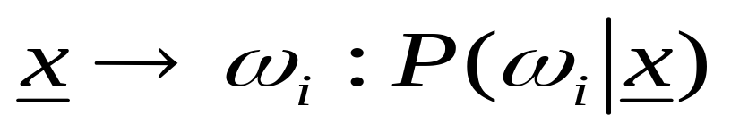
CLASSIFIERS BASED ON BAYES DECISION THEORY
Statistical nature of feature vectors
Assign the pattern represented by feature vector
to the most probable of the available classes
That is
maximum

Slide 8

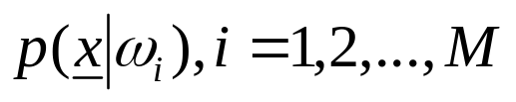
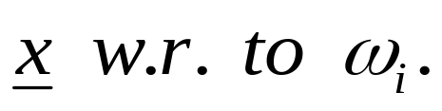
Computation of a-posteriori probabilities
  Assume known
    a-priori probabilities
    This is also known as the likelihood of

Slide 9
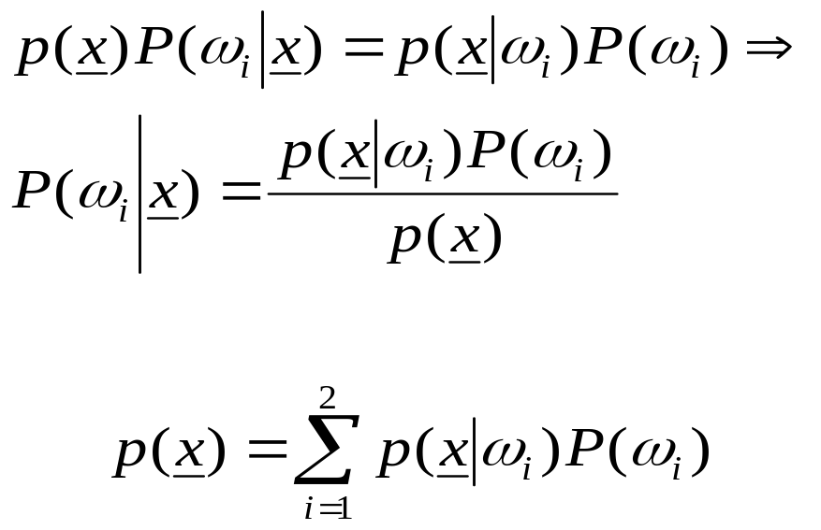
  The Bayes rule (Μ=2)
where

Slide 10

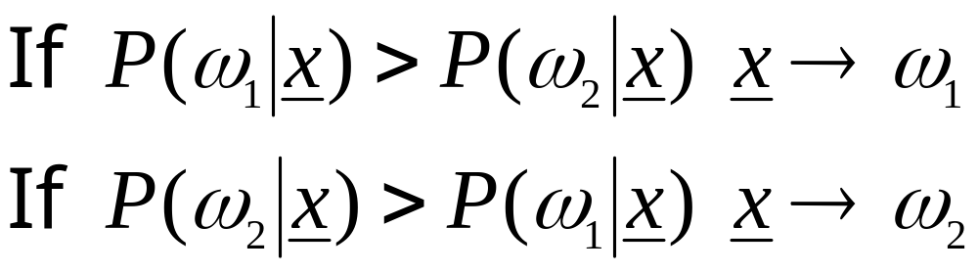

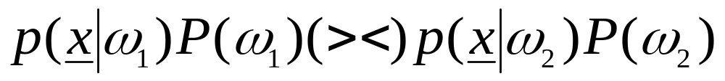
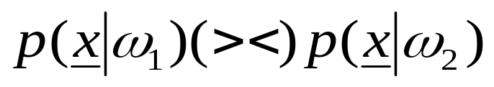
The Bayes classification rule (for two classes M=2)
  Given classify it according to the rule
  Equivalently: classify according to the rule
  For equiprobable classes the test becomes

Slide 11
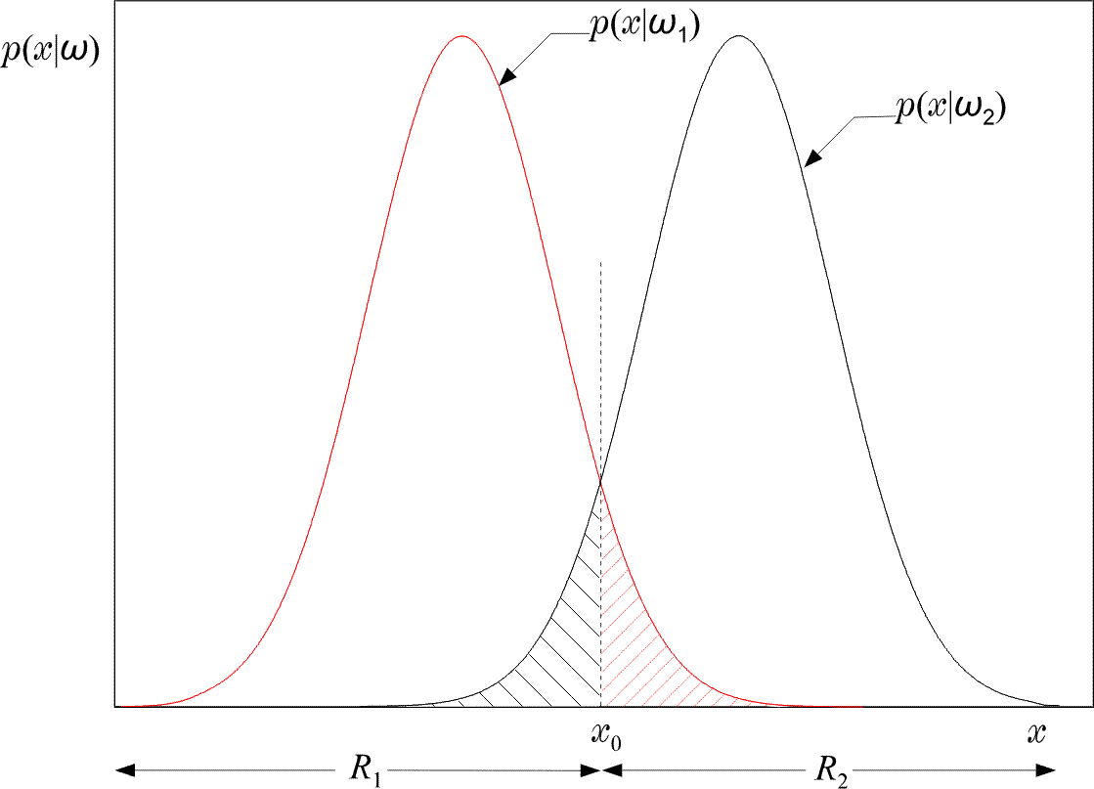
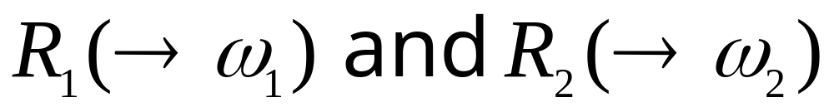

Slide 12
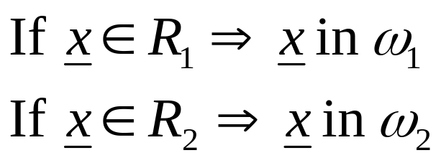
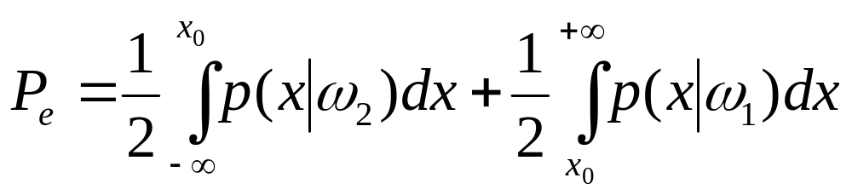
Equivalently in words: Divide space in two regions
Probability of error
  Total shaded area
Bayesian classifier is OPTIMAL with respect to minimising the classification error probability!!!!

Slide 13
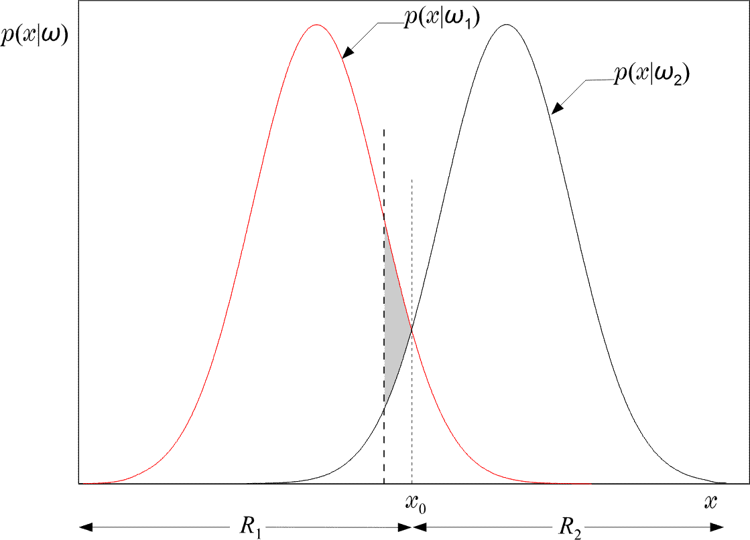
  Indeed: Moving the threshold the total shaded area INCREASES by the extra “gray” area.

Slide 14

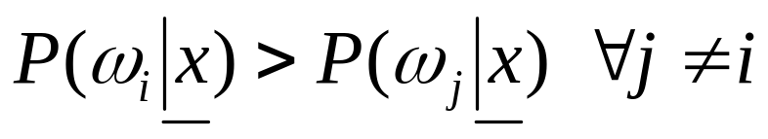
The Bayes classification rule for many (M>2) classes:
  Given classify it to if:
  Such a choice also minimizes the classification error probability
Minimizing the average risk
  For each wrong decision, a penalty term is assigned since some decisions are more sensitive than others

Slide 15
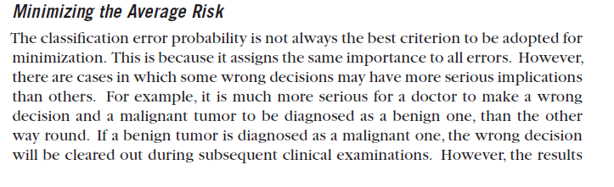

Slide 16
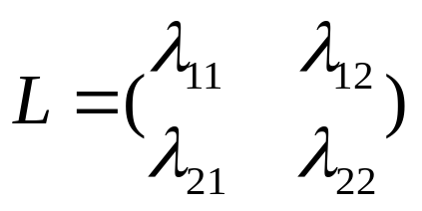

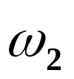

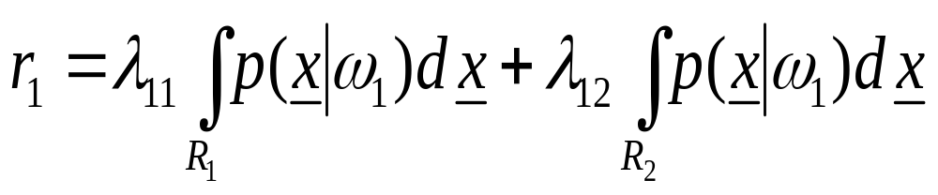
  For M=2
    Define the loss matrix
    penalty term for deciding class ,
    although the pattern belongs to , etc.
  Risk with respect to

Slide 17
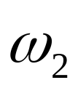
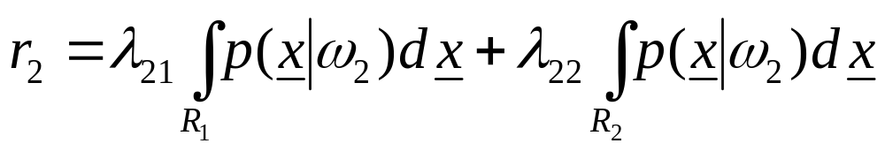

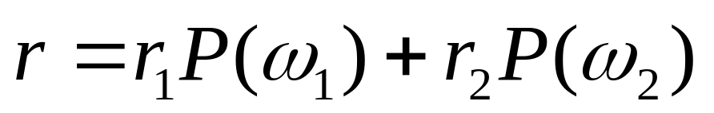
  Risk with respect to
  Average risk
Probabilities of wrong decisions, weighted by the penalty terms

Slide 18


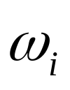
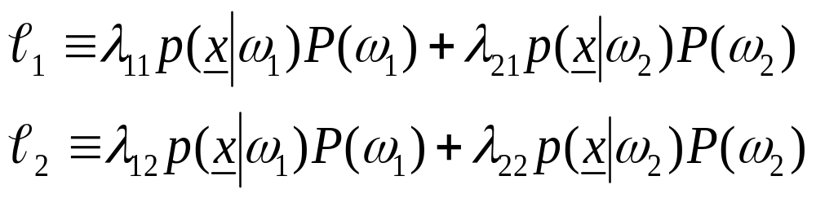
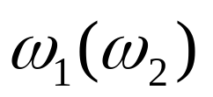
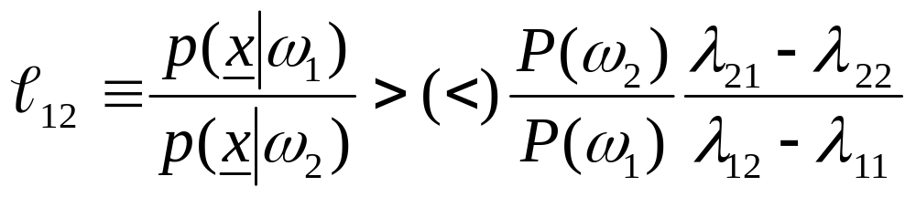
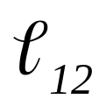
Choose and so that r is minimized
Then assign to if
Equivalently:
assign x in if
: likelihood ratio

Slide 19
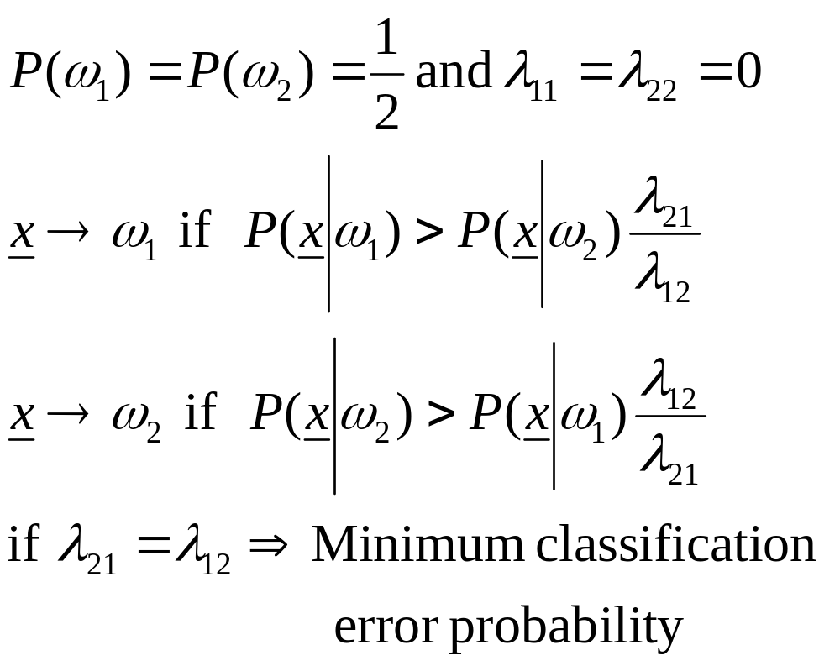
If

Slide 20
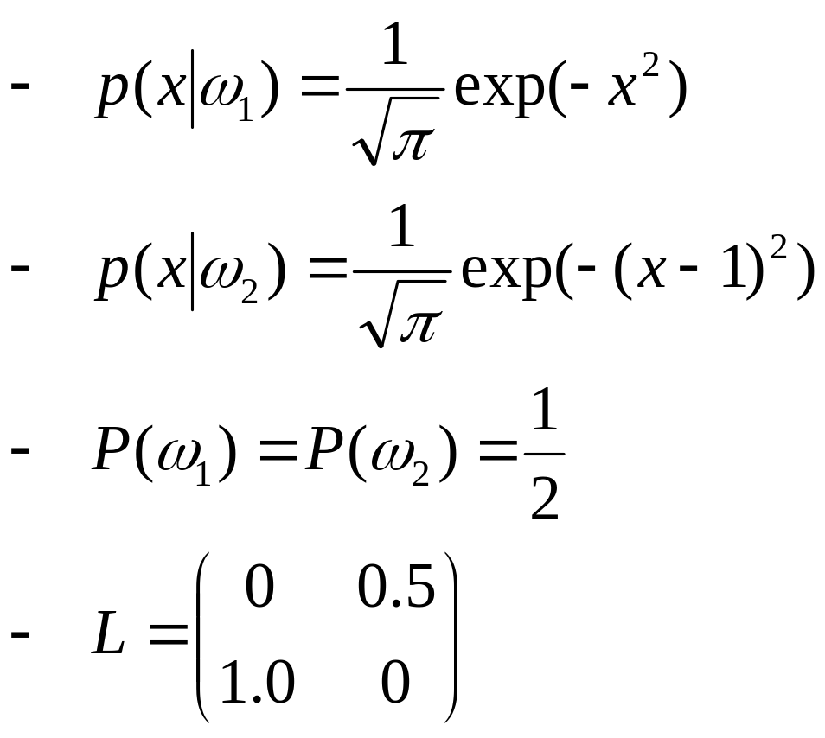
An example:

Slide 21
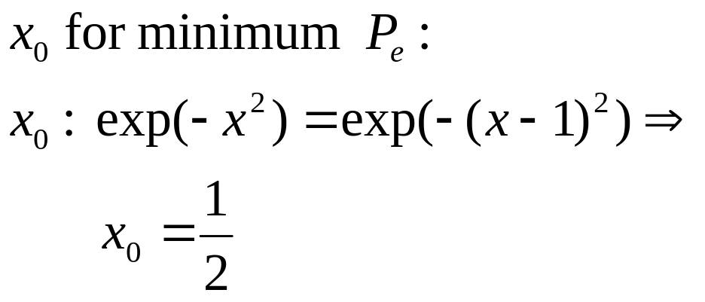
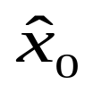
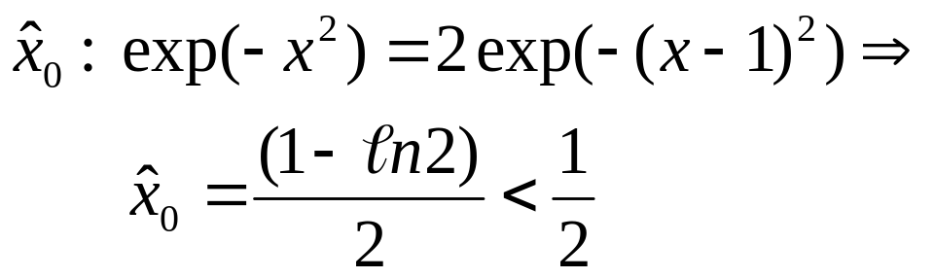
  Then the threshold value is:
  Threshold for minimum r

Slide 22
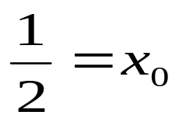
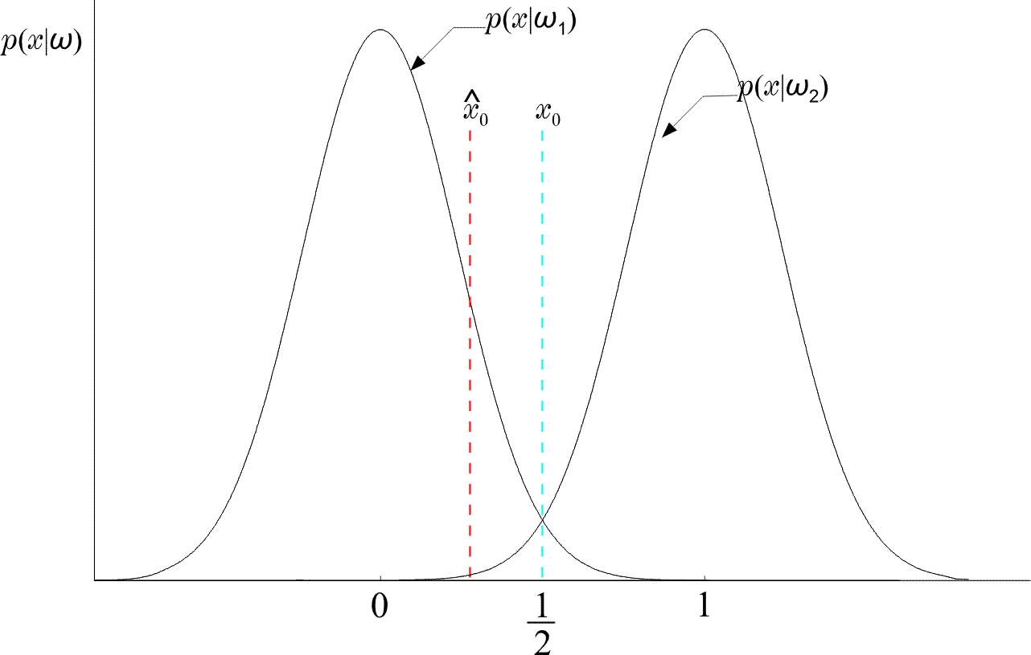
  Thus moves to the left of
  (WHY?)

Slide 23
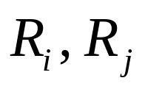
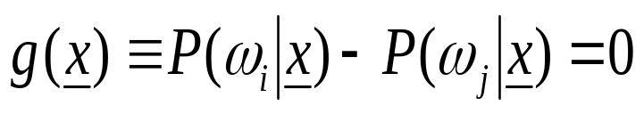
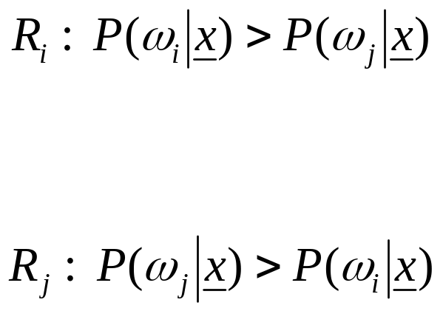

DISCRIMINANT FUNCTIONS
DECISION SURFACES
If are contiguous:
is the surface separating the regions. On the one side is positive (+), on the other is negative (-). It is known as Decision Surface.
+
-

Slide 24
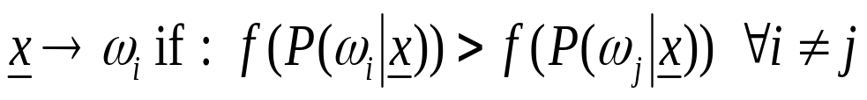
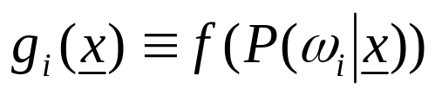
If f (.) monotonically increasing, the rule remains the same if we use:
is a discriminant function.
In general, discriminant functions can be defined independent of the Bayesian rule. They lead to suboptimal solutions, yet, if chosen appropriately, they can be computationally more tractable. Moreover, in practice, they may also lead to better solutions. This, for example, may be case if the nature of the underlying pdf’s are unknown.

Slide 25
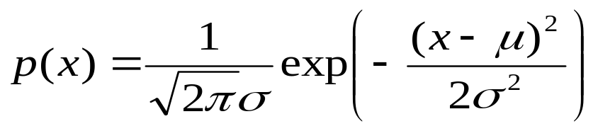
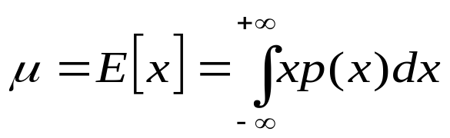

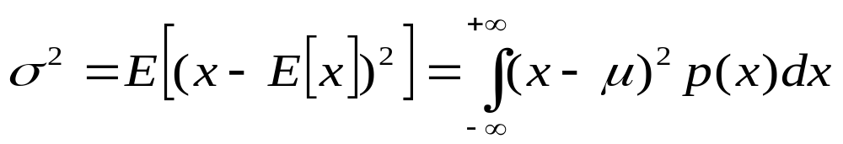

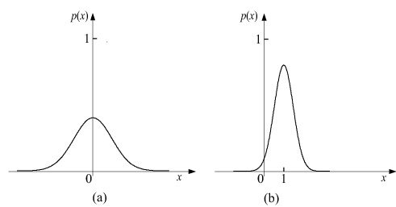
THE GAUSSIAN DISTRIBUTION
The one-dimensional case
where
is the mean value, i.e.:
is the variance,

Slide 26
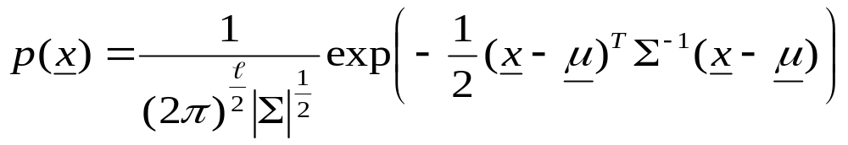




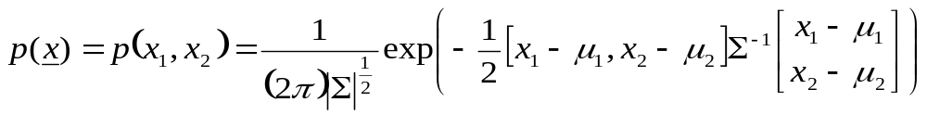
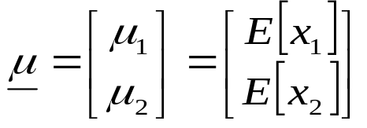


The Multivariate (Multidimensional) case:
where is the mean value,
and is known s the covariance matrix and it is defined as:
An example: The two-dimensional case:
,
where

Slide 27


BAYESIAN CLASSIFIER FOR NORMAL DISTRIBUTIONS
Multivariate Gaussian pdf
  is the covariance matrix.

Slide 28




is monotonic. Define:
  Example:

Slide 29



  That is, is quadratic and the surfaces
    quadrics, ellipsoids, parabolas, hyperbolas,
    pairs of lines.

Slide 30




Example 1:
Example 2:

Slide 31



Decision Hyperplanes
  Quadratic terms:
  If ALL (the same) the quadratic terms are not of interest. They are not involved in comparisons. Then, equivalently, we can write:
  Discriminant functions are LINEAR.

Slide 32

  Let in addition:

Slide 33




  Remark :
    If , then

Slide 34


    If , the linear classifier moves towards the class with the smaller probability

Slide 35





  Nondiagonal:
  Decision hyperplane

Slide 36






Minimum Distance Classifiers
  equiprobable
  Euclidean Distance:
  smaller
  Mahalanobis Distance:
  smaller

Slide 37


Slide 38



Example:

Slide 39

ESTIMATION OF UNKNOWN PROBABILITY
DENSITY FUNCTIONS
Maximum Likelihood

Slide 40


Slide 41


Slide 42

  Asymptotically unbiased and consistent

Slide 43

Example:

Slide 44


Example

Slide 45


Slide 46


Example

Slide 47



Maximum Aposteriori Probability Estimation
  In ML method, θ was considered as a parameter
  Here we shall look at θ as a random vector described by a pdf p(θ), assumed to be known
  Given
  Compute the maximum of
  From Bayes theorem

Slide 48

  The method:

Slide 49


Slide 50

Example:

Slide 51

Bayesian Inference

Slide 52



Slide 53




  The previous formulae correspond to a sequence of Gaussians for different values of N.
Example : Prior information : , ,
True mean .

Slide 54


Maximum Entropy Method
Compute the pdf so that to be maximally non-committal to the unavailable information and constrained to respect the available information.
The above is equivalent with maximizing uncertainty,
i.e., entropy, subject to the available constraints.
  Entropy

Slide 55




  Example: x is nonzero in the interval
  and zero otherwise. Compute the ME pdf
    The constraint:
    Lagrange Multipliers

Slide 56
    This is most natural. The “most random” pdf is the uniform one. This complies with the Maximum Entropy rationale.
  It turns out that, if the constraints are the: mean value and the variance
  then the Maximum Entropy estimate is the Gaussian pdf.
  That is, the Gaussian pdf is the “most random” one, among all pdfs with the same mean and variance.

Slide 57





Mixture Models
  Assume parametric modeling, i.e.,
  The goal is to estimate
    given a set
  Why not ML? As before?

Slide 58

  This is a nonlinear problem due to the missing label information. This is a typical problem with an incomplete data set.
  The Expectation-Maximisation (EM) algorithm.
    General formulation
      which are not observed directly.
      We observe
    a many to one transformation

Slide 59




    Let
    What we need is to compute
    But are not observed. Here comes the EM. Maximize the expectation of the loglikelihood conditioned on the observed samples and the current iteration estimate of

Slide 60






  The algorithm:
    E-step:
    M-step:
  Application to the mixture modeling problem
    Complete data
    Observed data
    Assuming mutual independence

Slide 61




    Unknown parameters
    E-step
    M-step

Slide 62








Nonparametric Estimation
  In words : Place a segment of length h at and count points inside it.
  If is continuous: as , if

Slide 63



Parzen Windows
  Place at a hypercube of length and count points inside.

Slide 64





  Define
    That is, it is 1 inside a unit side hypercube centered at 0
    The problem:
    Parzen windows-kernels-potential functions

Slide 65






  Mean value
  Hence unbiased in the limit

Slide 66

  Variance
    The smaller the h the higher the variance
h=0.1, N=1000
h=0.8, N=1000

Slide 67

h=0.1, N=10000
  The higher the N the better the accuracy

Slide 68



  If
  asymptotically unbiased
  The method
    Remember:

Slide 69
CURSE OF DIMENSIONALITY
  In all the methods, so far, we saw that the highest the number of points, N, the better the resulting estimate.
  If in the one-dimensional space an interval, filled with N points, is adequate (for good estimation), in the two-dimensional space the corresponding square will require N² and in the ℓ-dimensional space the ℓ-dimensional cube will require N^{ℓ} points.
  The exponential increase in the number of necessary points in known as the curse of dimensionality. This is a major problem one is confronted with in high dimensional spaces.

Slide 70

  An Example :

Slide 71



NAIVE – BAYES CLASSIFIER
  Let and the goal is to estimate
  i = 1, 2, …, M. For a “good” estimate of the pdf one would need, say, N^{ℓ} points.
  Assume x₁, x₂ ,…, x_{ℓ} mutually independent. Then:
  In this case, one would require, roughly, N points for each pdf. Thus, a number of points of the order N·ℓ would suffice.
  It turns out that the Naïve – Bayes classifier works reasonably well even in cases that violate the independence assumption.

Slide 72


K Nearest Neighbor Density Estimation
  In Parzen:
    The volume is constant
    The number of points in the volume is varying
  Now:
    Keep the number of points
    constant
    Leave the volume to be varying

Slide 73



Slide 74


The Nearest Neighbor Rule
  Choose k out of the N training vectors, identify the k nearest ones to x
  Out of these k identify k_{i} that belong to class ω_{i}
  The simplest version
  k=1 !!!
  For large N this is not bad. It can be shown that:
  if P_{B} is the optimal Bayesian error probability, then:

Slide 75




  For small P_{B}:
  An example:

Slide 76


Voronoi tesselation

Slide 77



BAYESIAN NETWORKS
Bayes Probability Chain Rule
  Assume now that the conditional dependence for each x_{i} is limited to a subset of the features appearing in each of the product terms. That is:
  where

Slide 78


  For example, if ℓ=6, then we could assume:
  Then:
  The above is a generalization of the Naïve – Bayes. For the Naïve – Bayes the assumption is:
  A_{i} = Ø, for i=1, 2, …, ℓ

Slide 79

  A graphical way to portray conditional dependencies is given below
  According to this figure we have that:
    x₆ is conditionally dependent on x₄, x₅
    x₅ on x₄
    x₄ on x₁, x₂
    x₃ on x₂
    x₁, x₂ are conditionally independent on other variables.
  For this case:

Slide 80
Bayesian Networks
  Definition: A Bayesian Network is a directed acyclic graph (DAG) where the nodes correspond to random variables. Each node is associated with a set of conditional probabilities (densities), p(x_{i}|A_{i}), where x_{i} is the variable associated with the node and A_{i} is the set of its parents in the graph.
  A Bayesian Network is specified by:
    The marginal probabilities of its root nodes.
    The conditional probabilities of the non-root nodes, given their parents, for ALL possible values of the involved variables.

Slide 81

  The figure below is an example of a Bayesian Network corresponding to a paradigm from the medical applications field.
  This Bayesian network models conditional dependencies for an example concerning smokers (S), tendencies to develop cancer (C) and heart disease (H), together with variables corresponding to heart (H1, H2) and cancer (C1, C2) medical tests.

Slide 82
  Once a DAG has been constructed, the joint probability can be obtained by multiplying the marginal (root nodes) and the conditional (non-root nodes) probabilities.
  Training: Once a topology is given, probabilities are estimated via the training data set. There are also methods that learn the topology.
  Probability Inference: This is the most common task that Bayesian networks help us to solve efficiently. Given the values of some of the variables in the graph, known as evidence, the goal is to compute the conditional probabilities for some of the other variables, given the evidence.

Slide 83

Example: Consider the Bayesian network of the figure:
a) If x is measured to be x=1 (x1), compute P(w=0|x=1) [P(w0|x1)].
b) If w is measured to be w=1 (w1) compute P(x=0|w=1) [ P(x0|w1)].

Slide 84
  For a), a set of calculations are required that propagate from node x to node w. It turns out that P(w0|x1) = 0.63.
  For b), the propagation is reversed in direction. It turns out that P(x0|w1) = 0.4.
  In general, the required inference information is computed via a combined process of “message passing” among the nodes of the DAG.
Complexity:
  For singly connected graphs, message passing algorithms amount to a complexity linear in the number of nodes.

